Slide 1

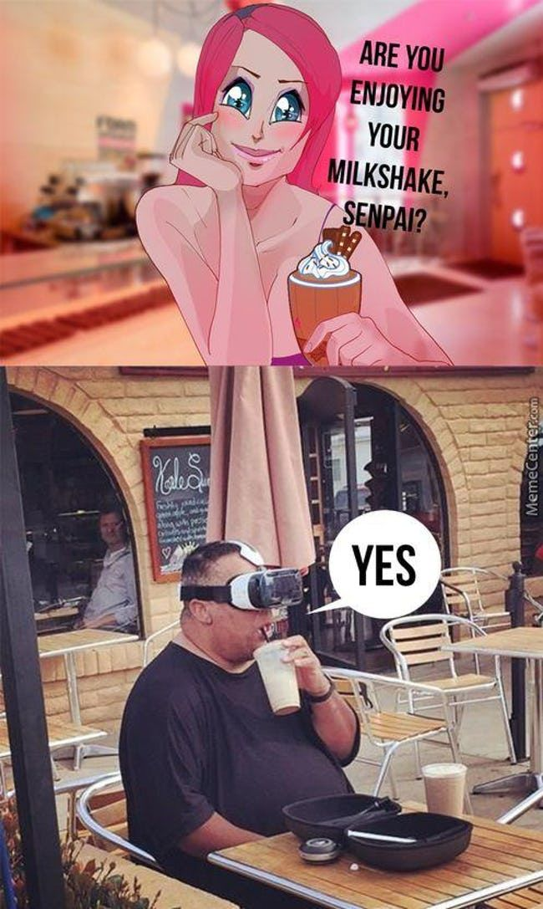



Slide 2

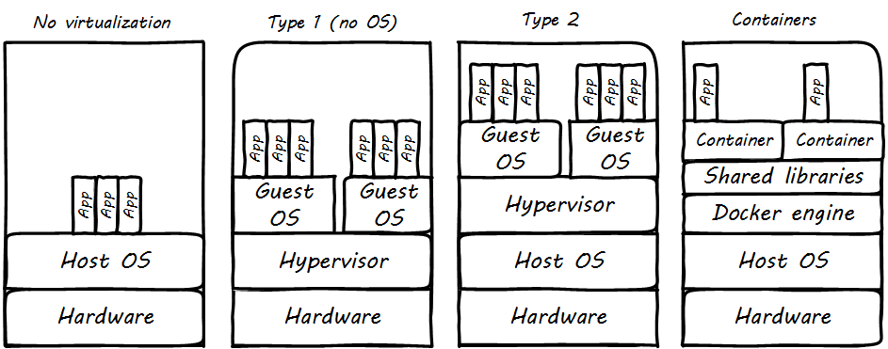

Pretty Please with a Gherkin On Top Tell Me What That Means Please (Please)
Virtualisation is the process of simulating a
computer within your computer. This computer can
have a different operating system to the host but it still uses the same physical resources.

Slide 3
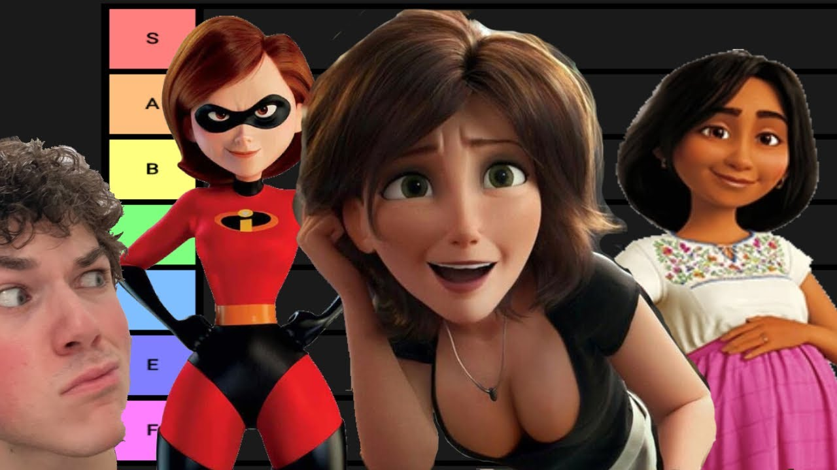
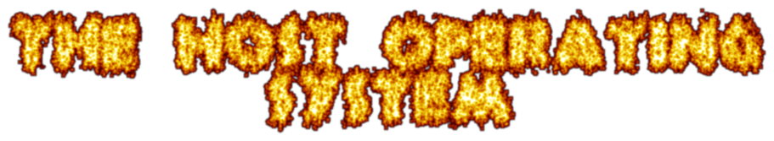

Slide 4
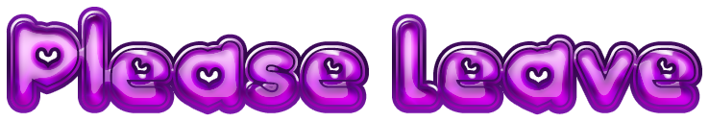


If you Don’t Know What An Operating System Is
The host operating system is responsible for managing processes in the host computer, including the hypervisor, and therefore the virtual machine as well. Very important. Gotta have it.
The Host Operating system is like a mother…
gentle, caring, womb, kernel and gentle

Slide 5
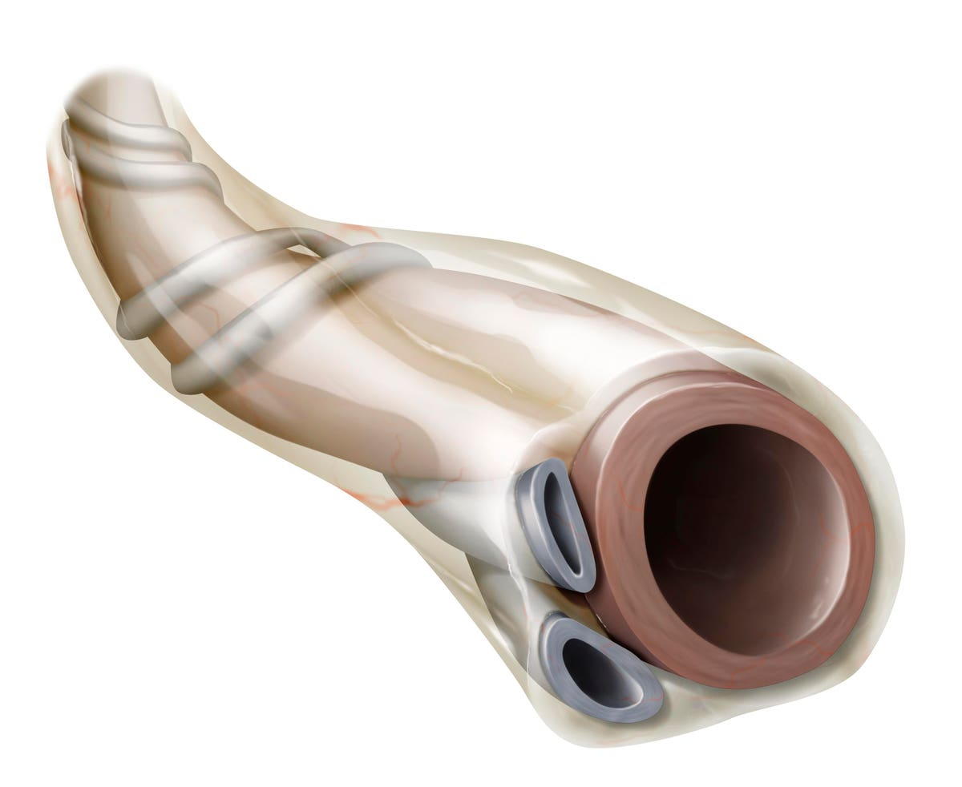


Slide 6

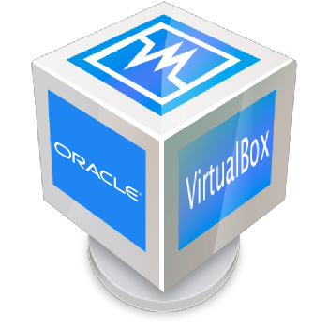

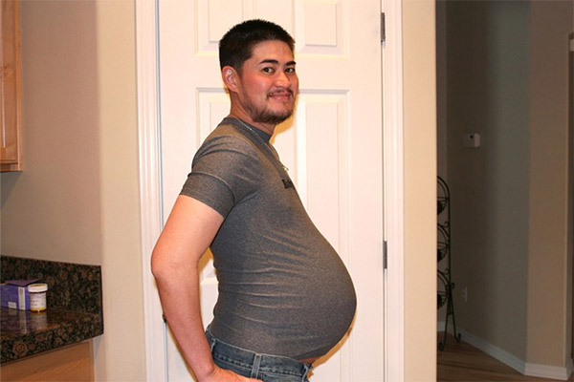
Hypervisor
The hypervisor is like the umbilical cord of the computer – feeding your baby virtual machine the nutrients it needs to function
The two most popular ones are VirtualBox and VMWare; we will be using VMWare in the labs but Virtual Box is better and we would recommend it for home use.

Slide 7
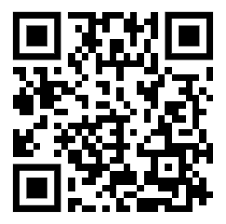
Hypervisor Part 2 – Resource Allocation Boogaloo
In a virtualisation setting you would use the hypervisor to format your virtual machine. In the creation process, you can decide the amount of resources allocated to simulated device as well as the version of the VDI save-states you’re using and where they’re stored.
There’s a very handy video guide on our YouTube that goes over the recommended settings for VMs

Slide 8
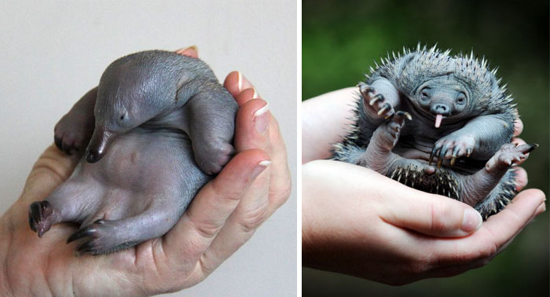


Slide 9

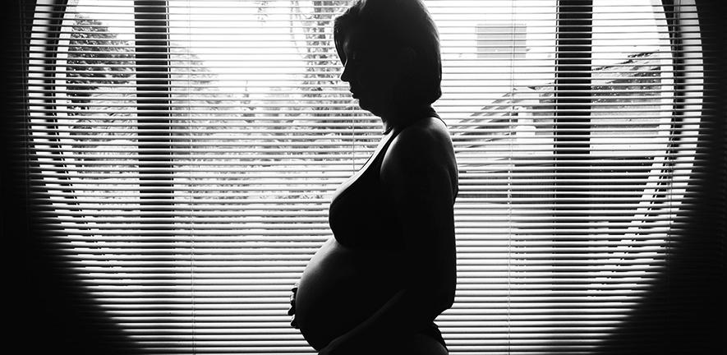



What the is a virtual machine???
(No seriously, what is a virtual machine? I have no idea, please guys)
A virtual version of a computer with it’s own operating system running on the host system
Host uses a hypervisation software to contain the machine
Uses the physical resources of the host computer
Virtual Machine is the baby

Slide 10

The Guest Operating System

Slide 11

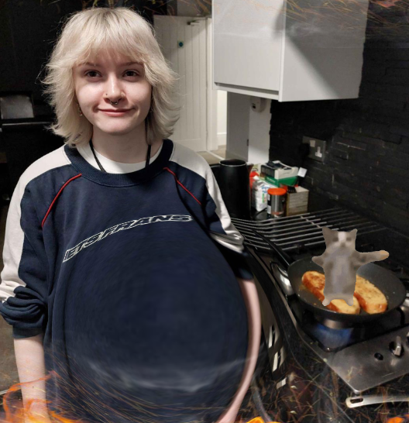
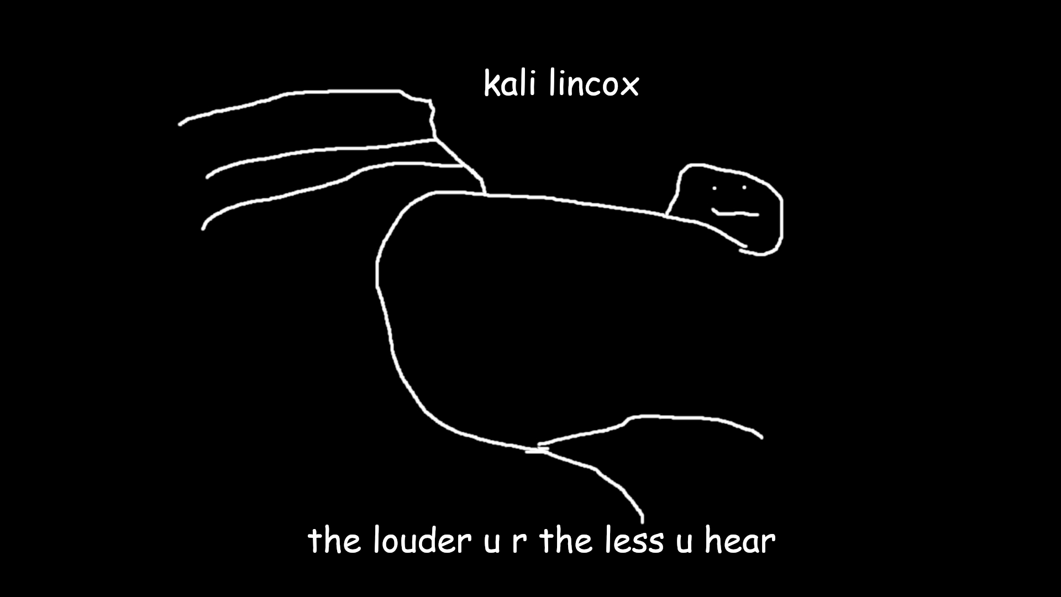
Hacker af
We will be using Kali as our Virtual Operating system for pretty much everything in our sessions
It is a linux-based operating system designed for ethical hackers – comes pre-installed with a bunch of useful hacking tools
The guest Operating System is the soul of the child. It’s the personality of your virtual machine.

Slide 12
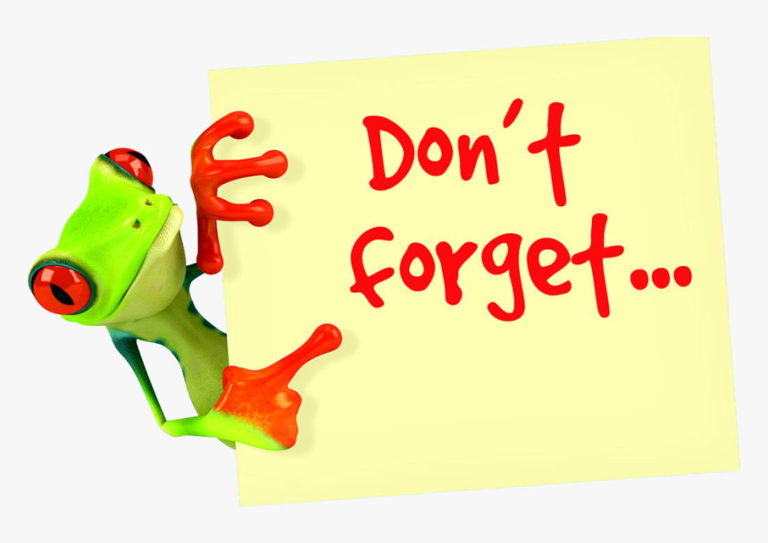

Slide 13
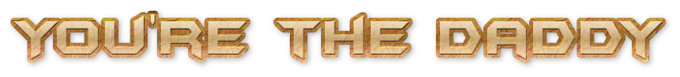


On a serious-ish note, the computers we will be using can be very dangerous in the wrong hands so it’s important to not use the skills you *might* acquire here ONLY when you have permission. Raise your “child” to be good. Nat and I will not be held responsible for any damages done (but we would find it really funny)

